Slide 1
SCHEME FOR FARMERS

Slide 2
INTRODUCTION
Agriculture plays a vital role for fulfilling one's daily needs and income of the nation.
Farmers are considered as the backbone of our nation and yet they don’t receive the deserving price for the cultivated crops.
Farmers scheme here lets the farmers to register themselves and sell their crops with the addition of the base price being their choice.

Slide 3
MODULES
Farmer module
Bidder module
Admin module

Slide 4
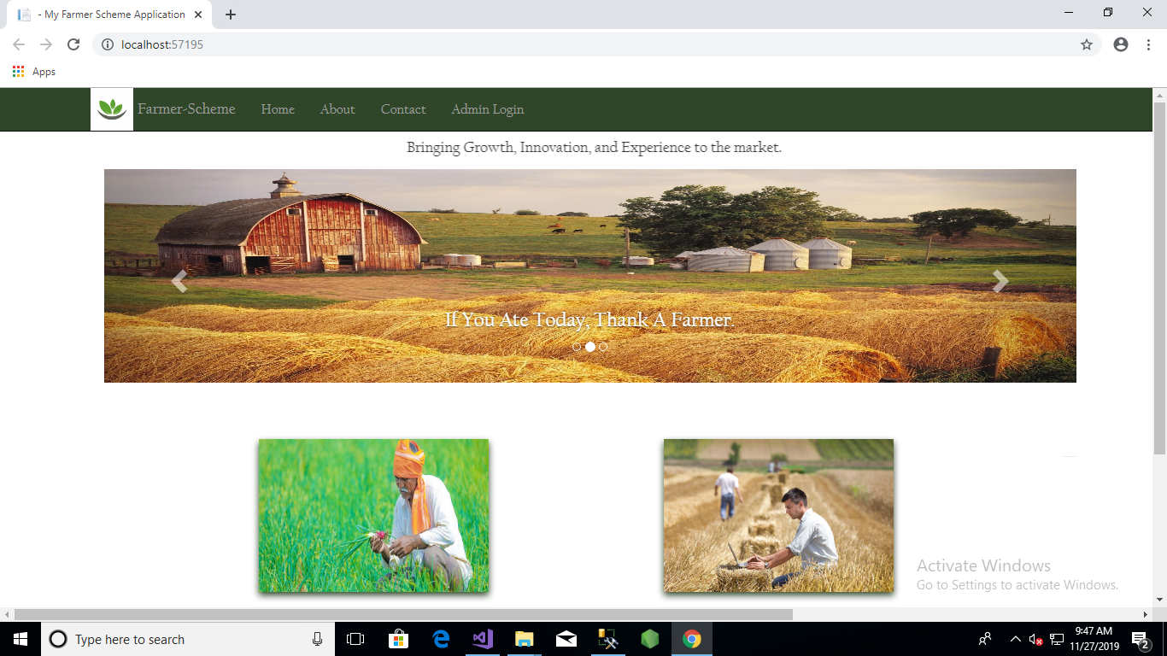
HOME PAGE
The homepage consist of four options on the navigation bar that is , Home, About us, Contact and log in.

Slide 5
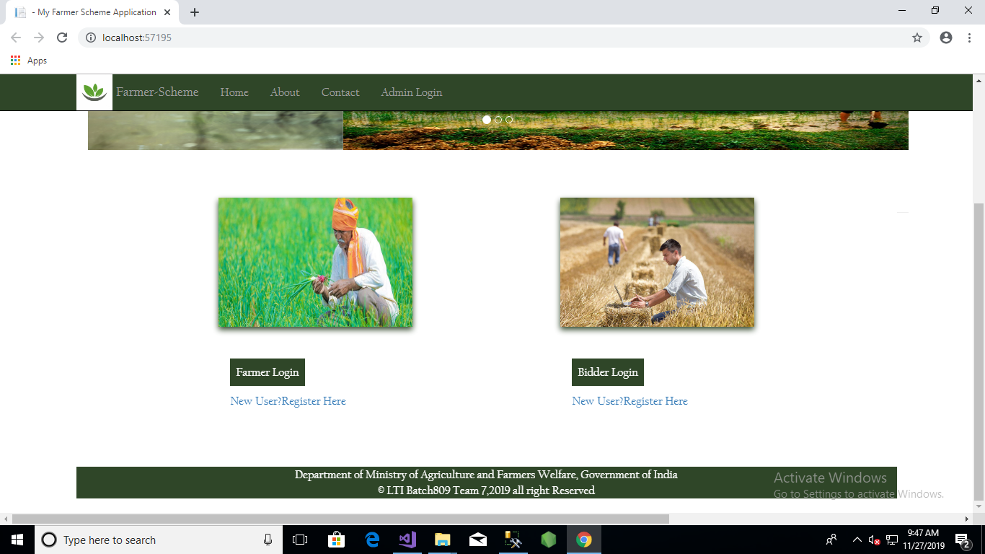
The home page also has the options required for a farmers and a bidder. The farmer/bidder can either register if he is a new user or they could log in into their accounts.

Slide 6
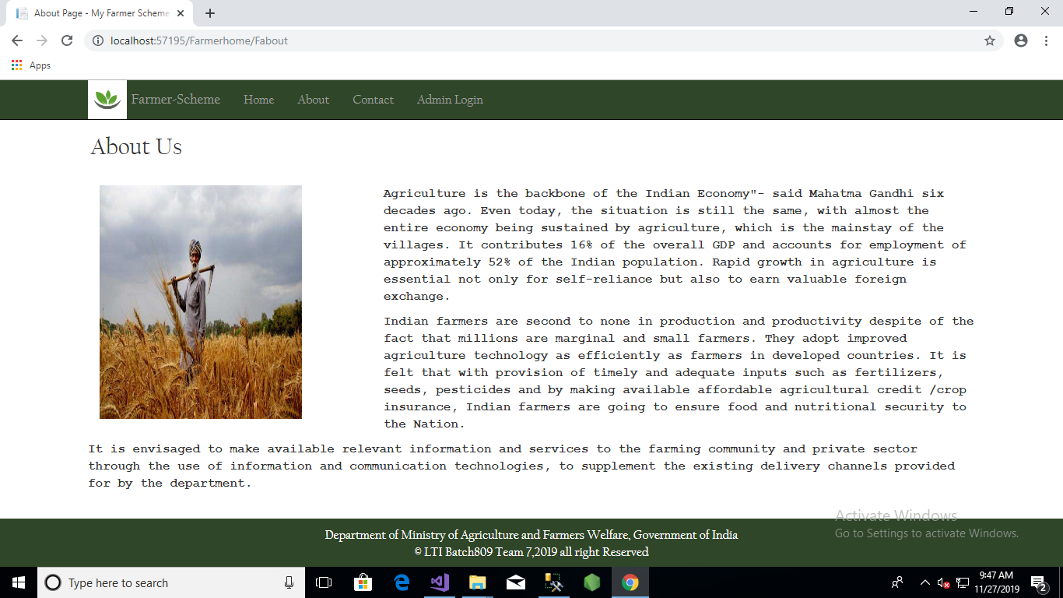
This page gives the basic understanding for the opportunities provided and the reason for it .

Slide 7
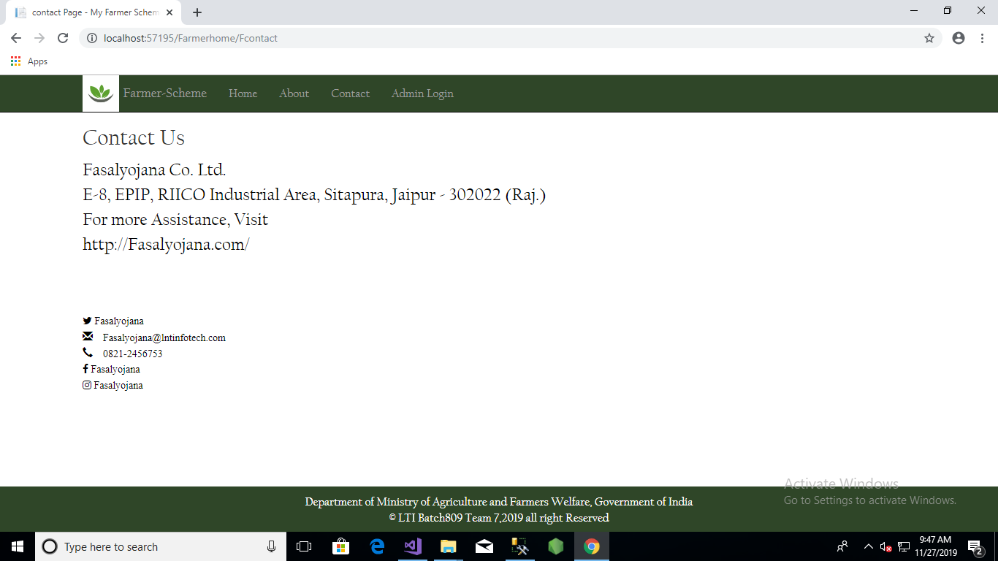
This page gives the users the required contact details incase of any queries.

Slide 8
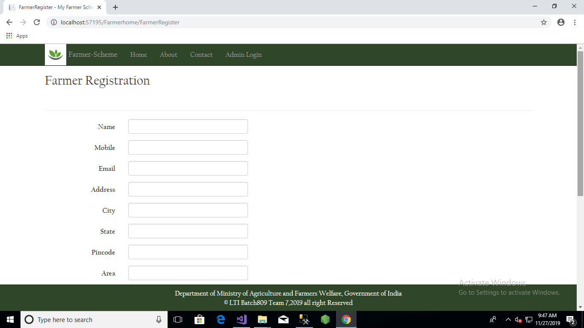
This is the farmer registration page where he submits his personal information that is required while creating a new account.

Slide 9
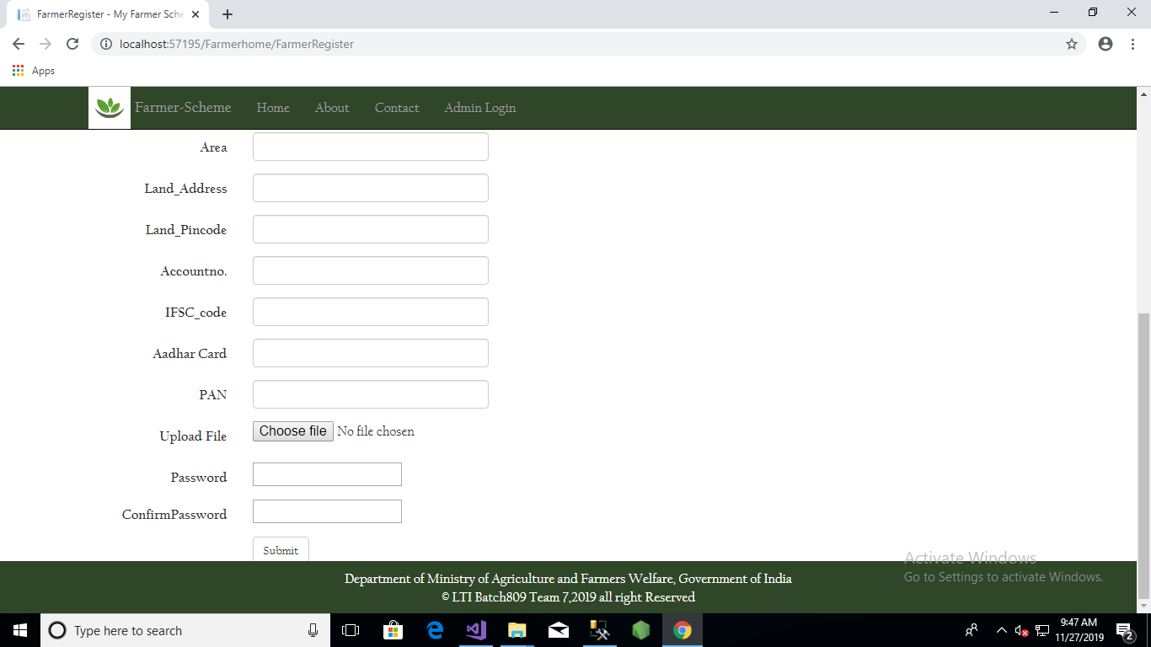
Farmer registration page continued.

Slide 10
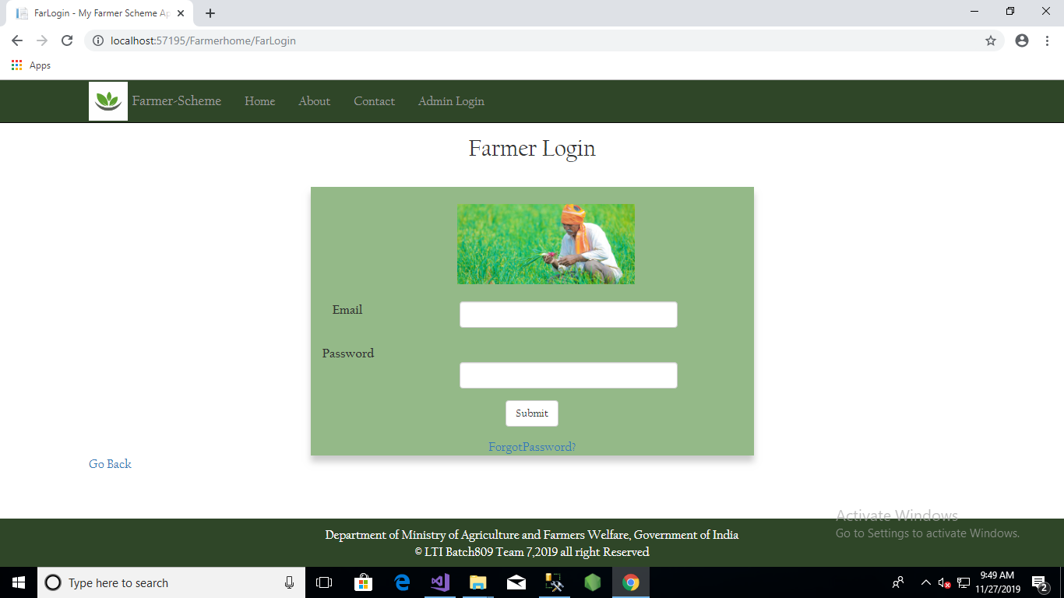
This the farmer log in page where the farmer can log into his account anytime after the registration.

Slide 11
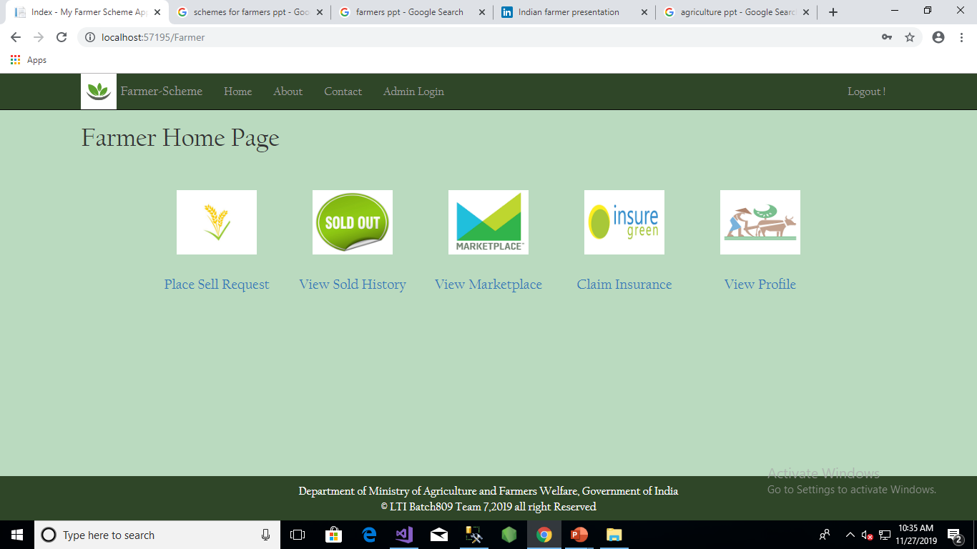
After the log in the farmer is provided with five options that is to sell his crop, view the sold history, view the marketplace, claim insurance if needed and view his own profile.

Slide 12
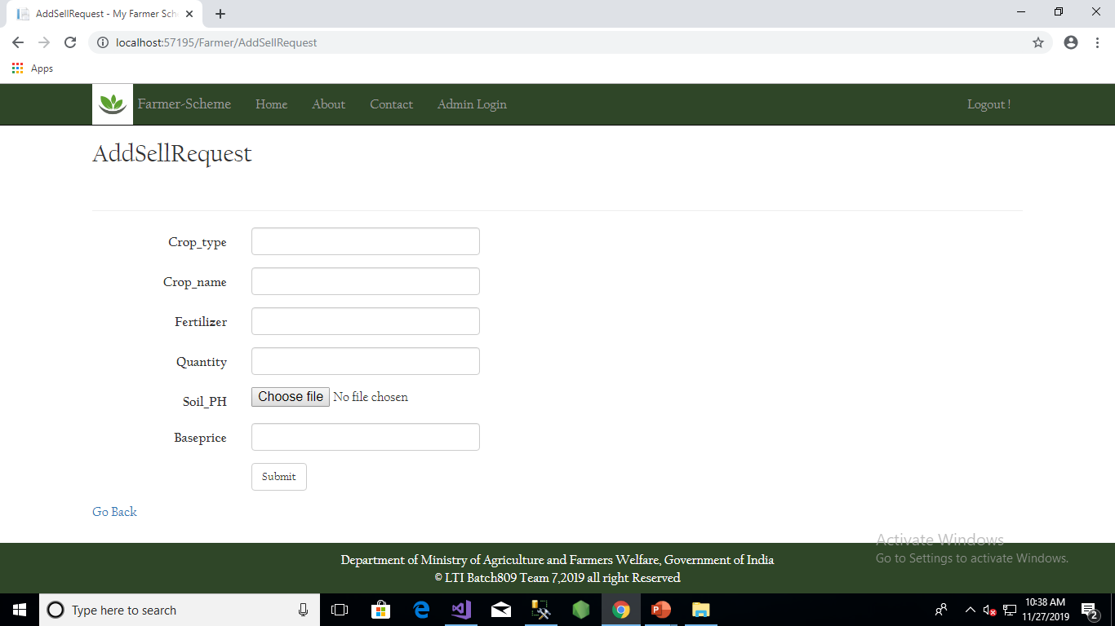
Add sell request lets the farmer submit the required information of the crop he wants to sell and the base price for the crop cultivated.

Slide 13
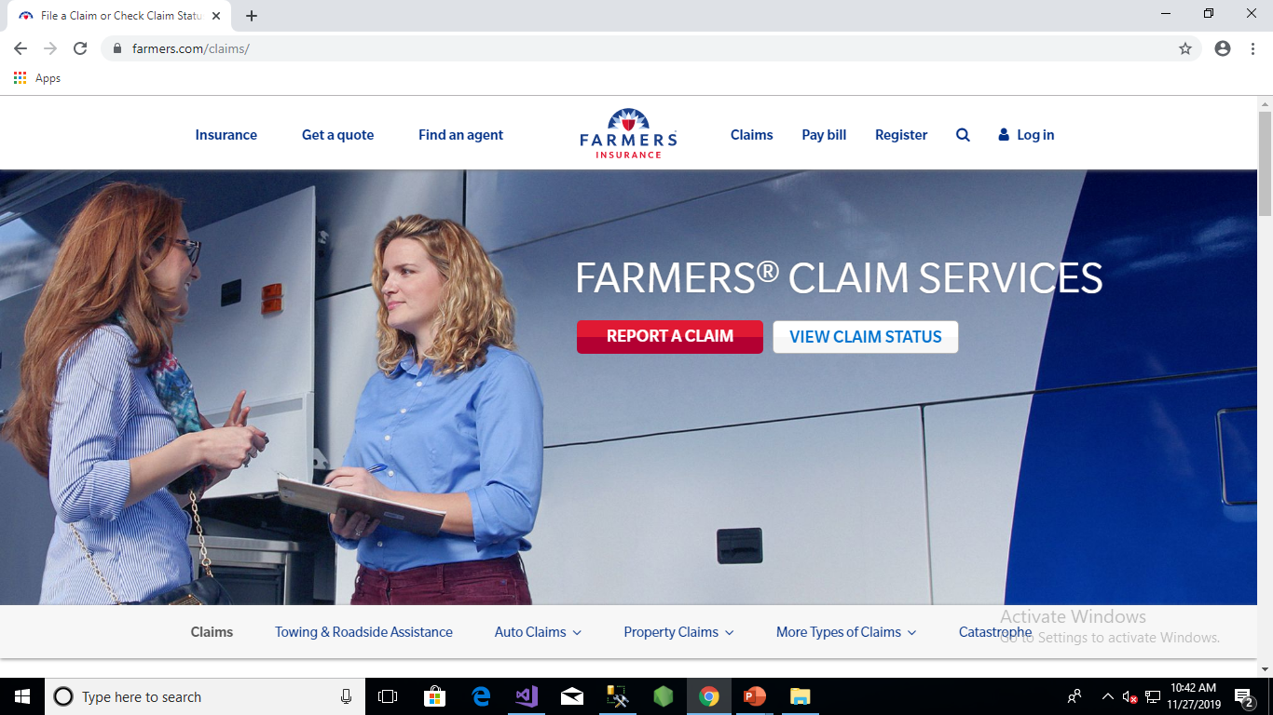
Claim insurance redirects the farmer to a website where he can apply for insurance

Slide 14
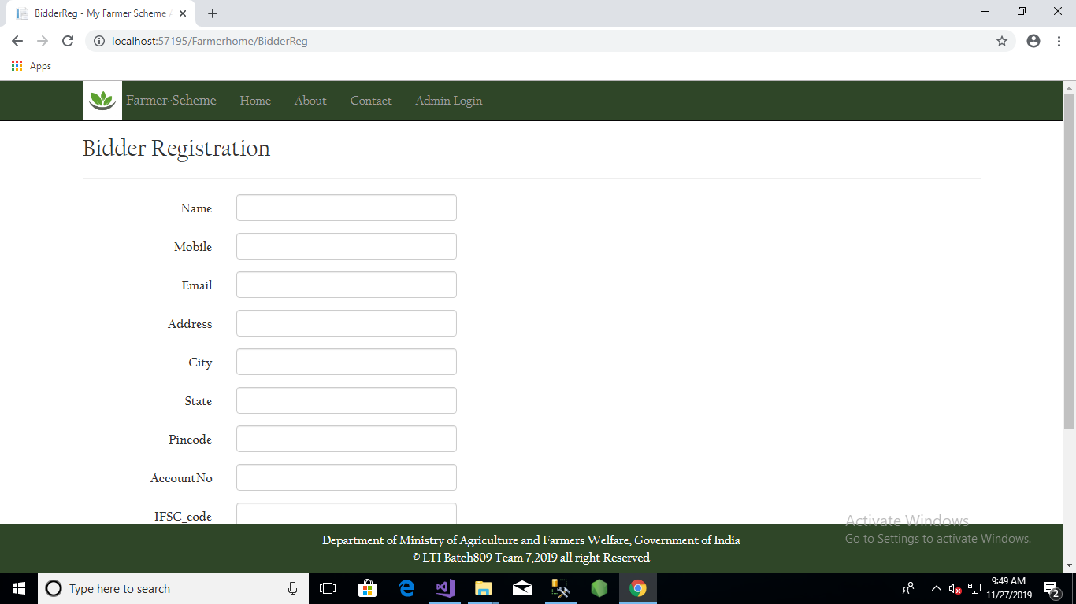
This is the bidder registration page where he submits his personal information that is required while creating a new account.

Slide 15
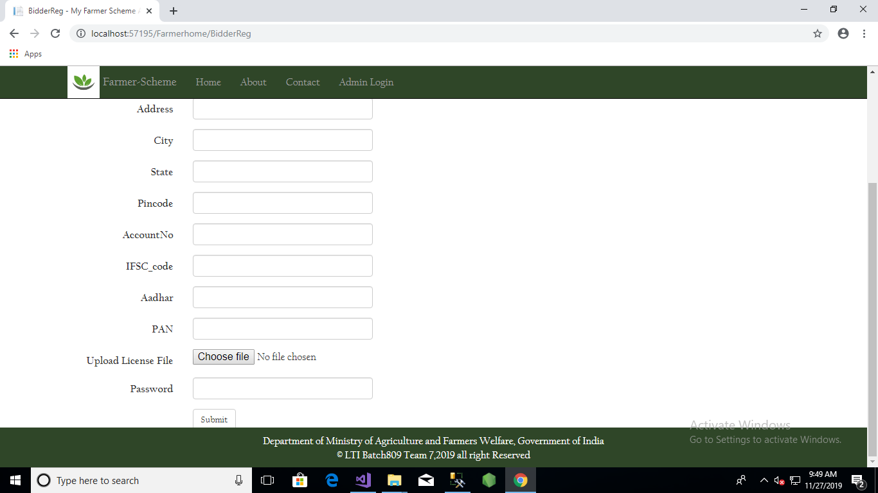
Bidder registration page continued.

Slide 16
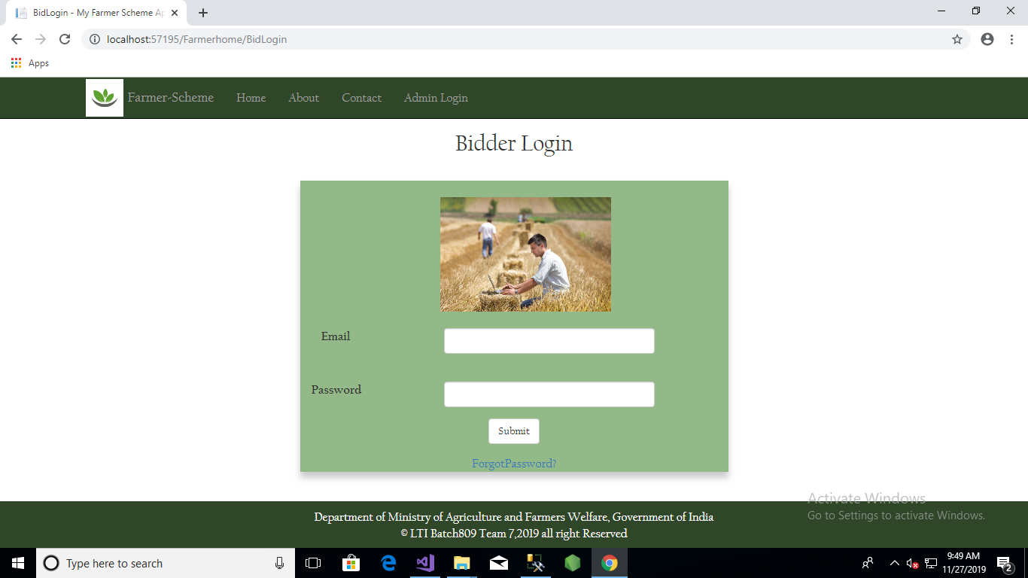
This the farmer log in page where the farmer can log into his account anytime after the registration.

Slide 17
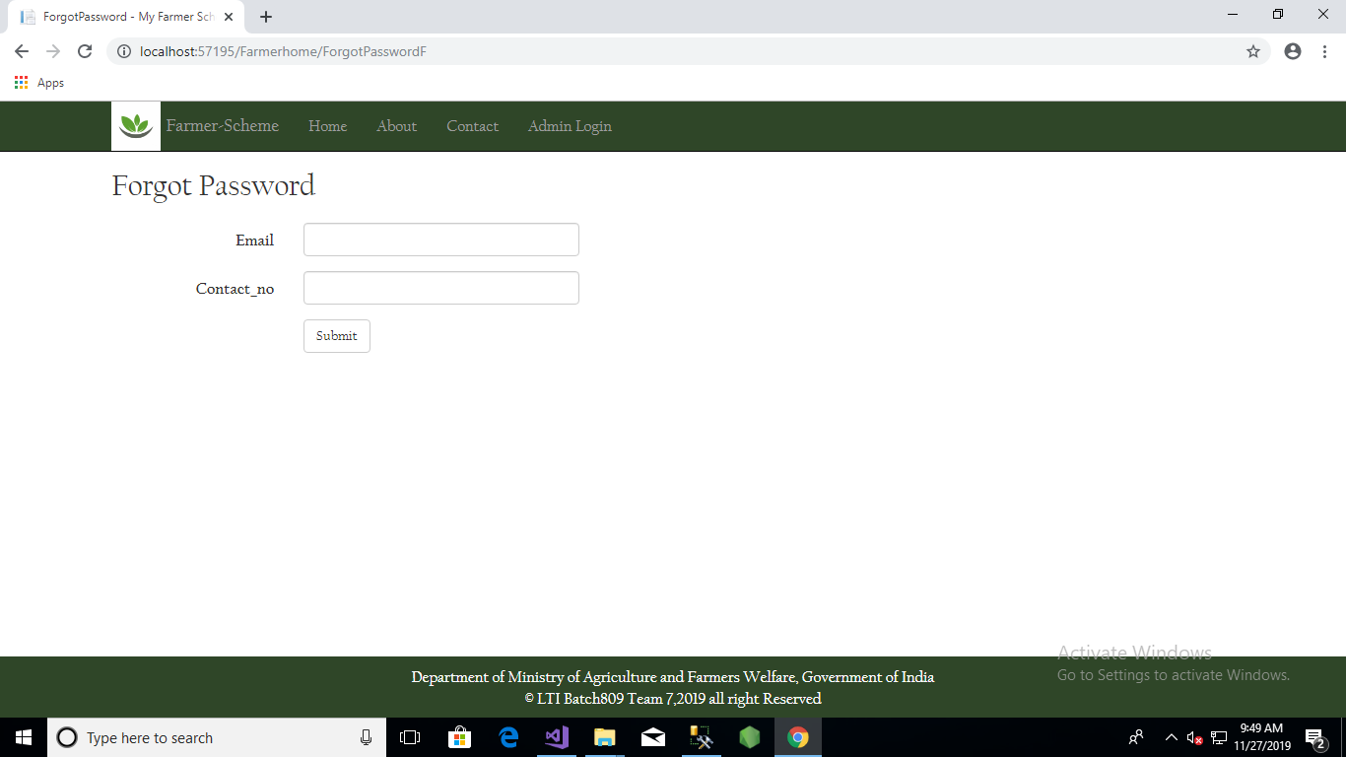
Forgot password option is provided to both the farmer and bidder incase the situation does occur. After entering the email and contact number the password will be sent to the concerned email id.

Slide 18
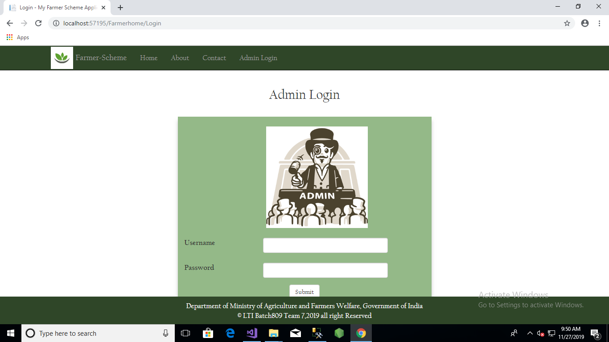
This the Admin log in page where the Admin can log into his account .

Slide 19
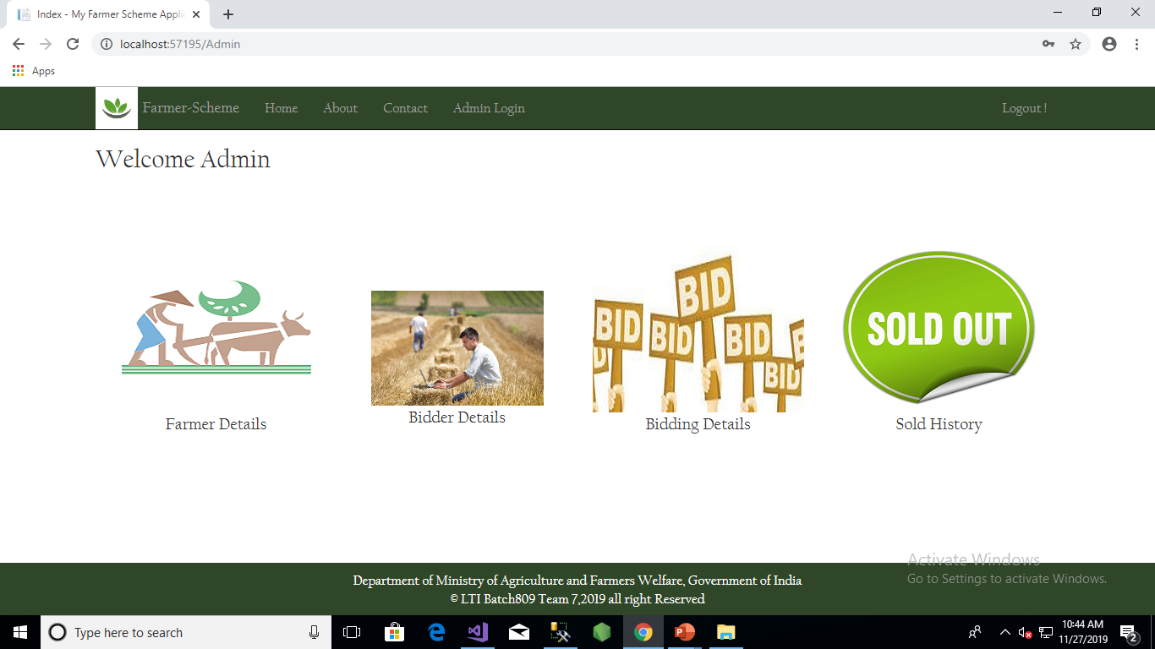
After the admin logs in he has the options to view the farmer details, bidder details, bidding details and the sold history.

Slide 20
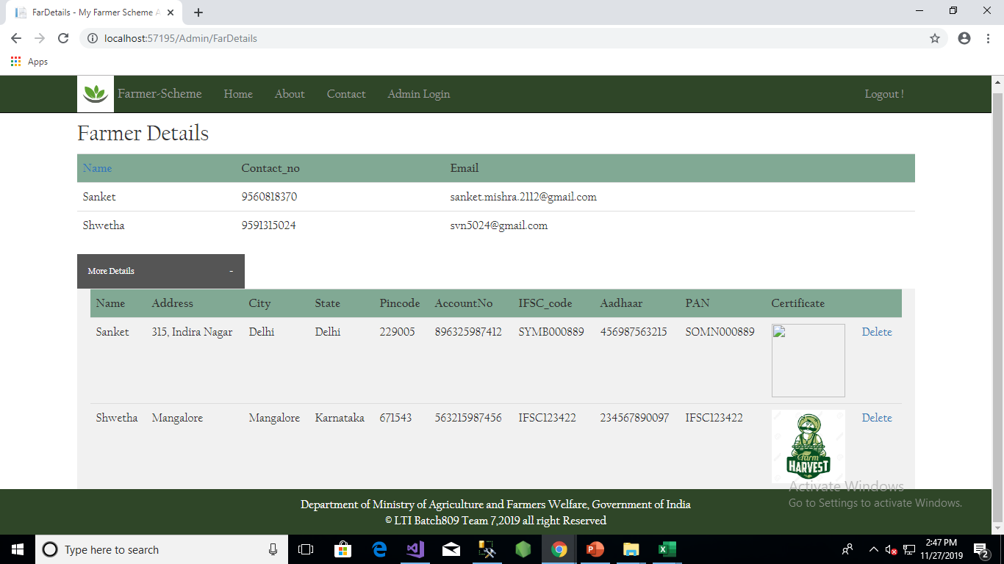
View Farmer Details

Slide 21
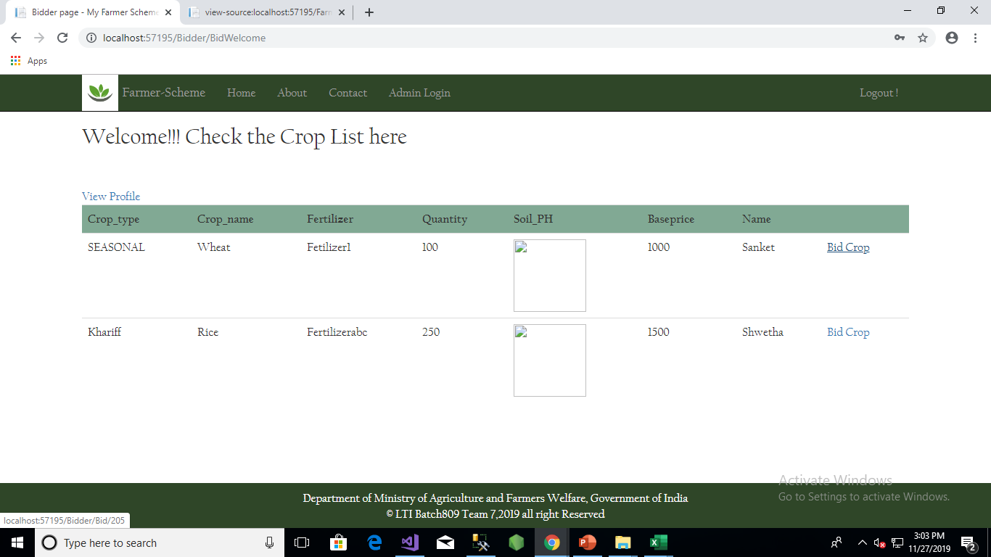
Viewing the Sell Requests

Slide 22
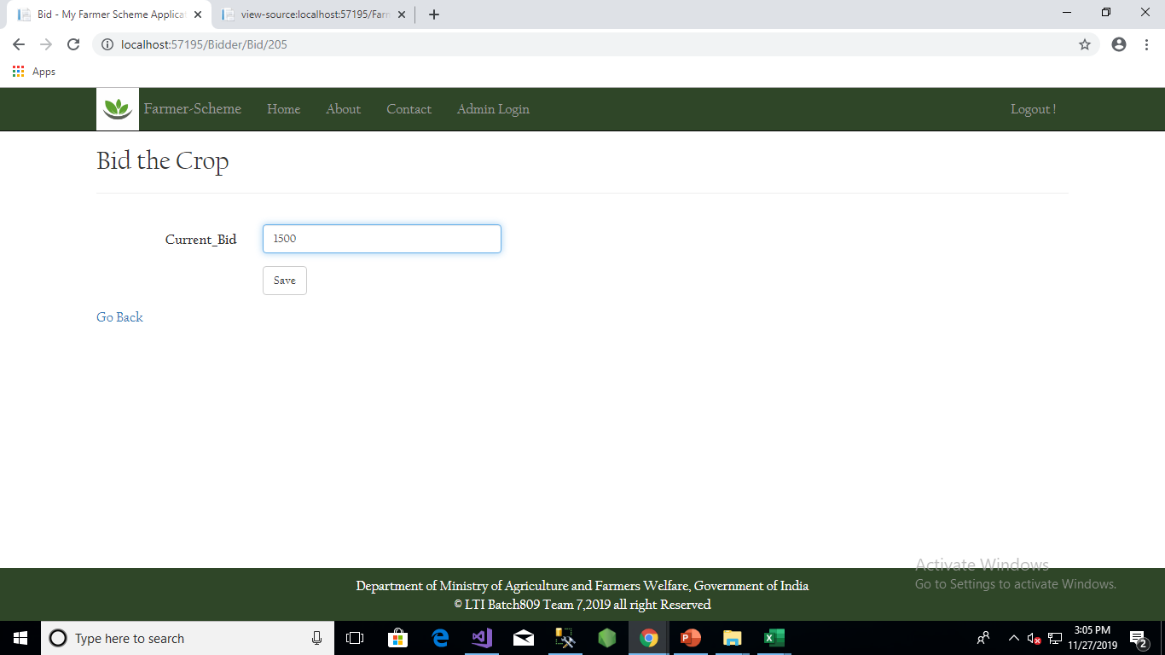
Bidder Enters the bid amount

Slide 23
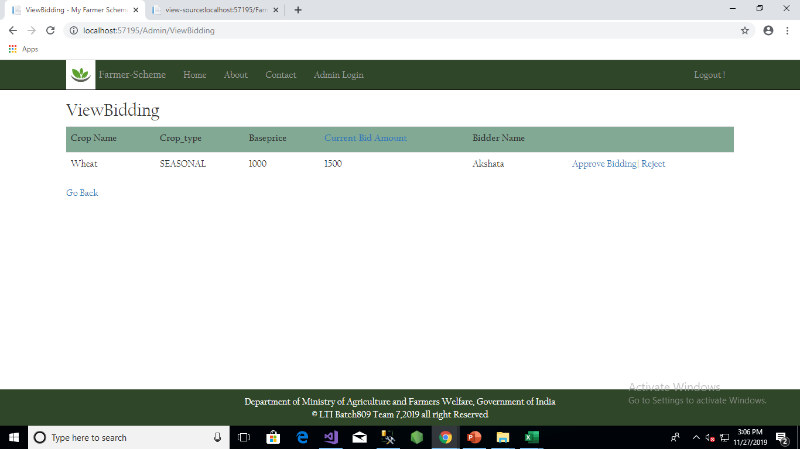
Admin Views the request and approves the request

Slide 24
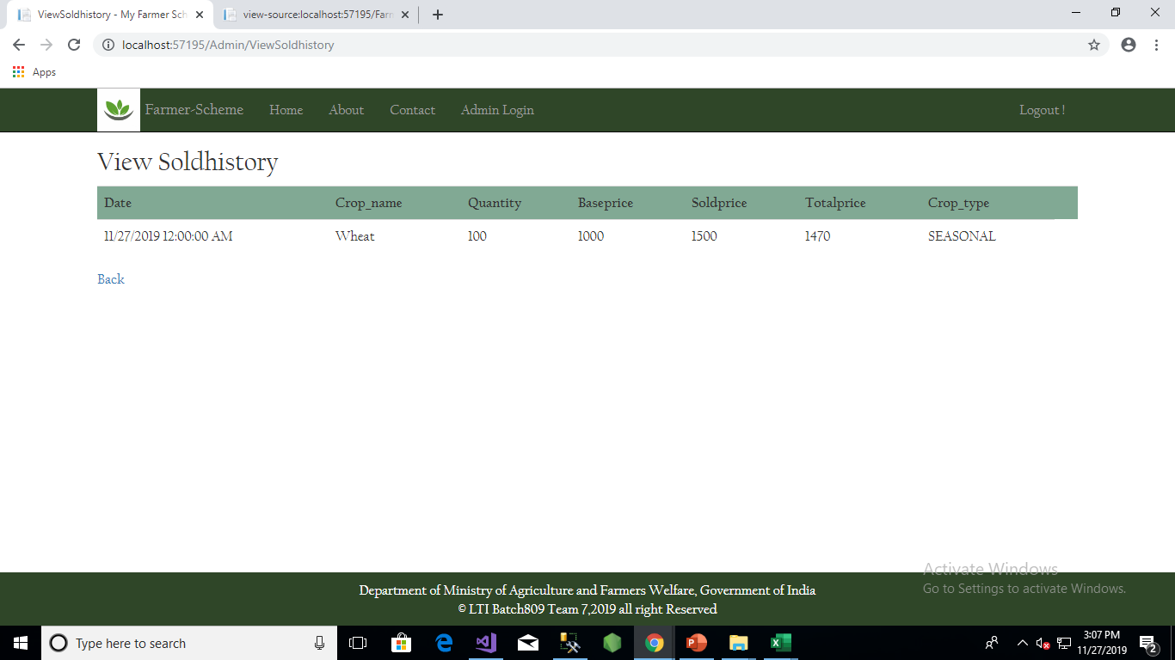
After admin approval the crop will be under sold history

Slide 25
THANK YOU

